Slide 1
GTU - COMPUTER ENGINEERING STUDENT CLUBS MANAGEMENT SOFTWARE
CSE 496 FINAL PRESENTATION
Muhammed OĞUZ
Süleyman GÖLBOL
Project Supervisors:
Assoc. Prof. Mehmet Göktürk
Research Assoc. Evren Çifçi
May 2023

Slide 2
Contents
Project Schema and Description
Link and QR Code
Overall UI - Client
Swagger - Server
Diagrams
Repository Folder Structure
Timeline
Success Criteria
References

Slide 3

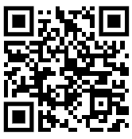
Link and QR Code
Our site link:
https://ogrenciprojeleri.gtu.edu.tr/KulupYonetim

Slide 4
Project Schema and Description
https://ogrenciprojeleri.gtu.edu.tr/KulupYonetim
The student clubs management system app offers three login options: member, club admin, and SKS (full admin). Members can join clubs and communicate with others, while club admins have additional privileges, such as managing events and approving new members. SKS users have full control over the app. Overall, the app provides a streamlined solution for student organizations to manage their operations and engage with members effectively.

Slide 5

OAuth 2.0
In this project we implement OAuth 2.0, which is an open standard for secure authentication and authorization. This allows users to grant limited access to their protected resources on one website (server) to another website or application (client) without sharing their credentials.
By integrating an OAuth provider that functions similarly to the E-Devlet authentication system, we were able to authenticate users using their existing credentials from trusted identity providers.
Through this process, we obtained user information such as the username and email.

Slide 6
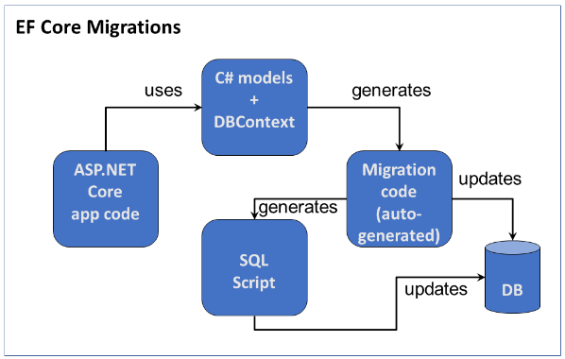
Migrations
We have decided to switch to using migrations in our project for better management of database changes. Migrations offer structured version control, easy synchronization across environments, and the ability to roll back changes if needed. This change improves collaboration, deployment processes, and overall project efficiency.

Slide 7
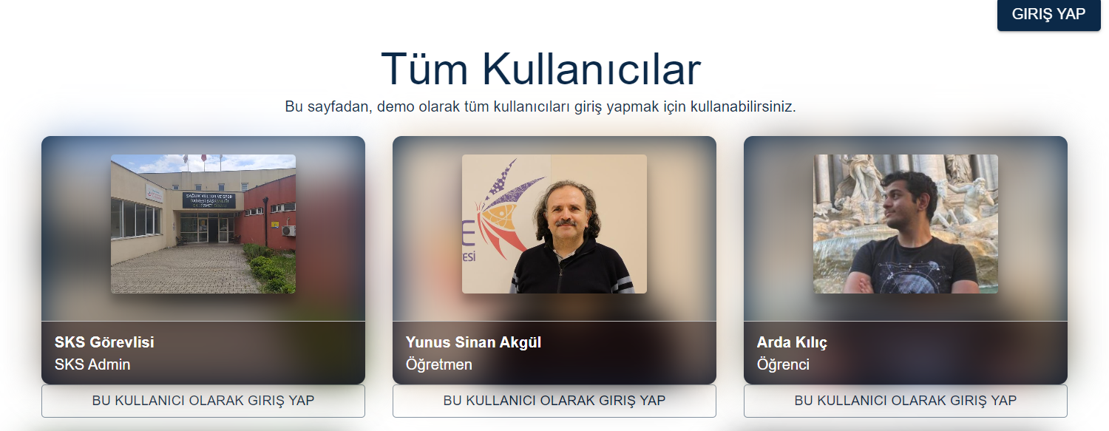
DEMO PAGE
We have created a demo page so that in the demo, a user can login as one of the some predefined users. So that tests can be made as different types of users.

Slide 8
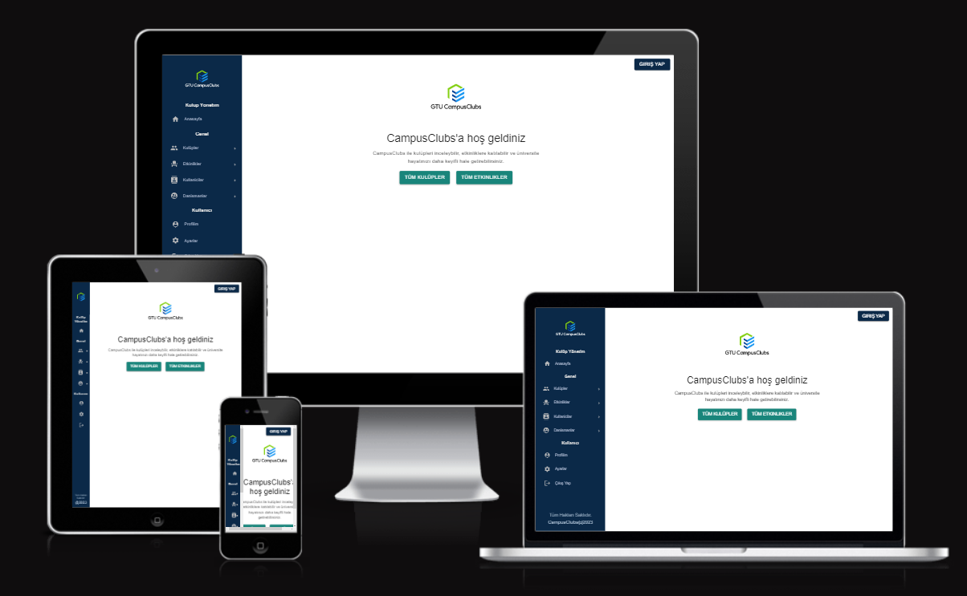
Overall UI - Home Page

Slide 9
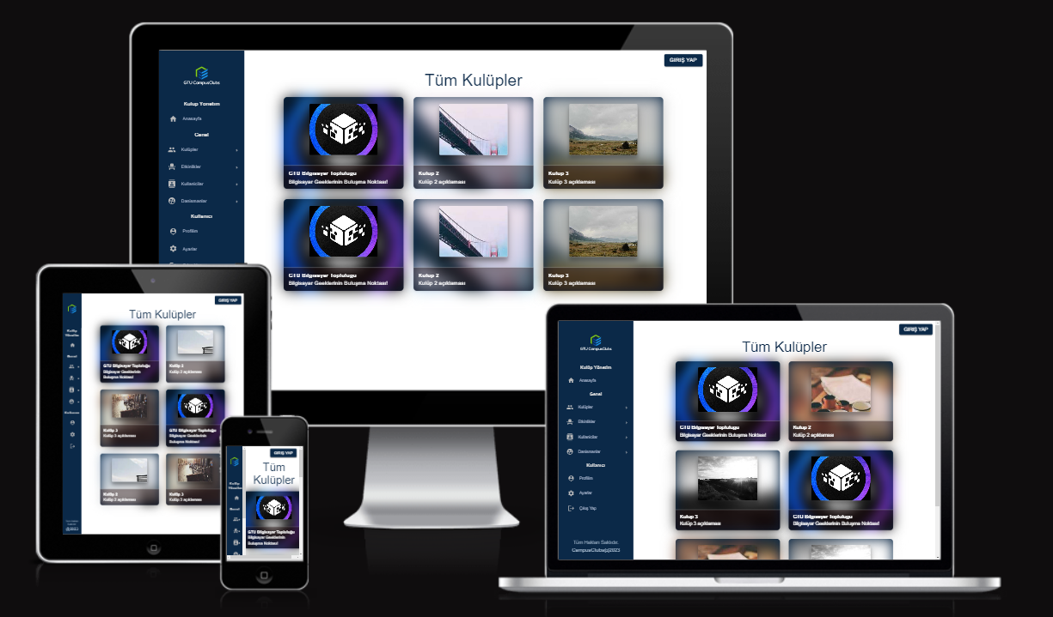
Overall UI - Clubs

Slide 10
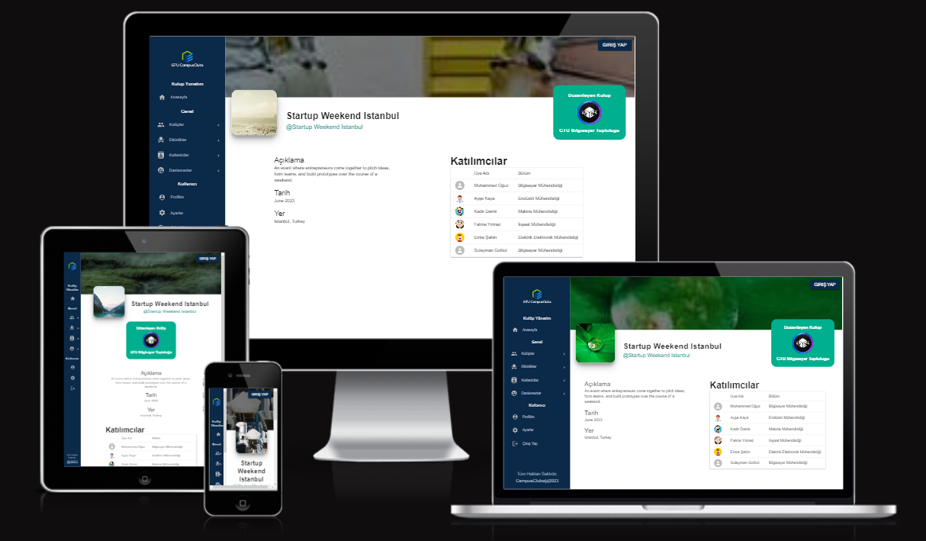
Overall UI - Event Home Page

Slide 11
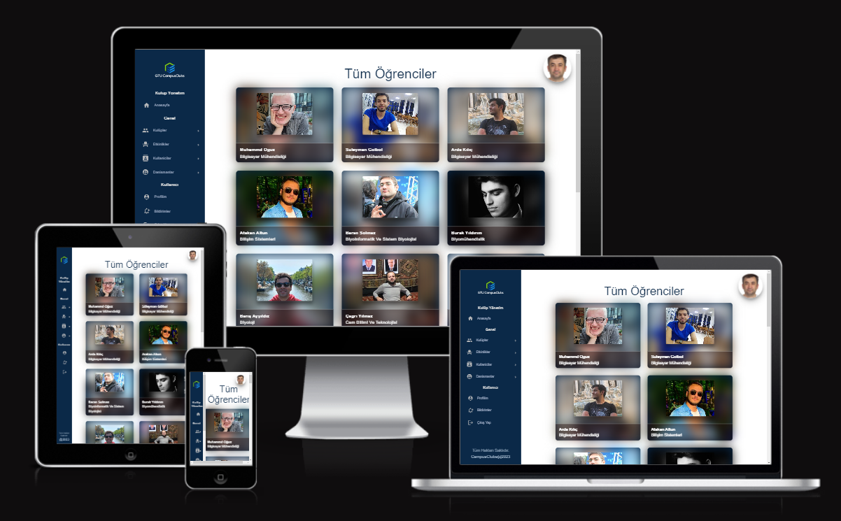
Overall UI - Students Page

Slide 12
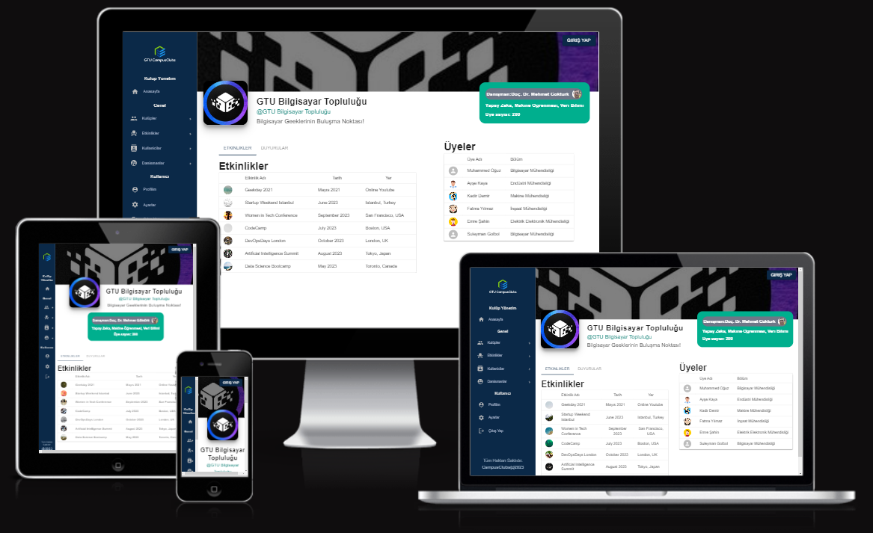
Overall UI - Club Profile

Slide 13
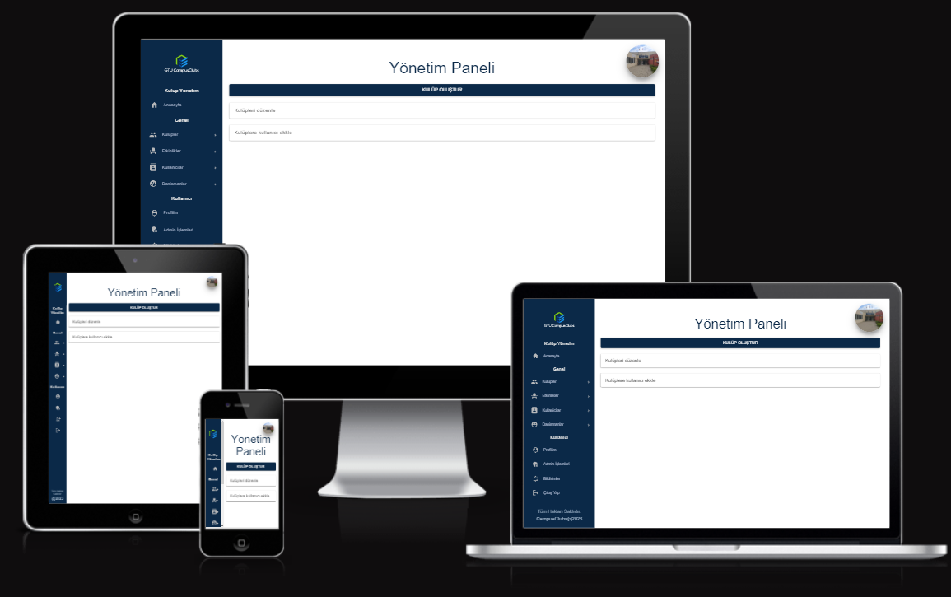
Overall UI - Super Admin Panel

Slide 14
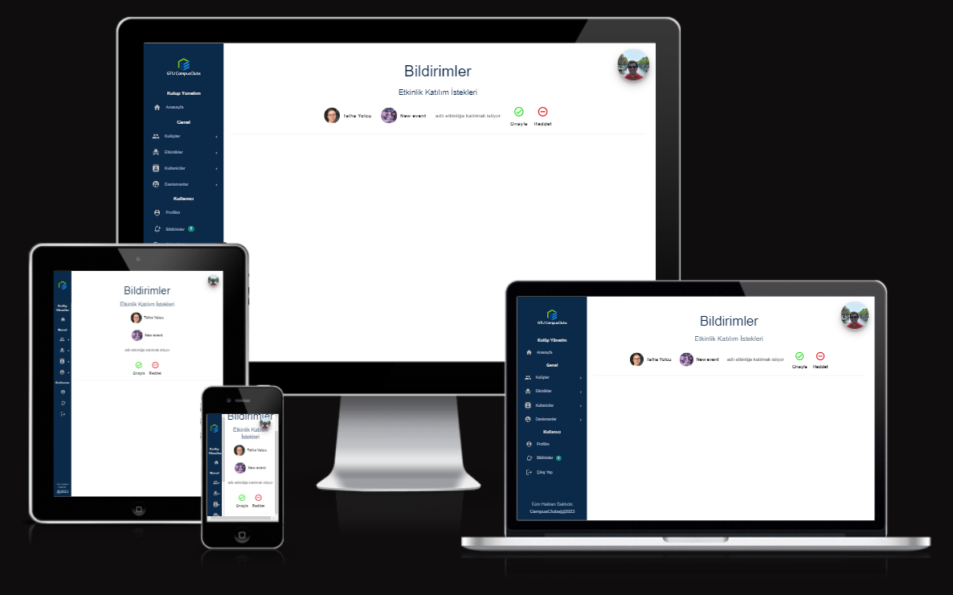
Overall UI - Club Approval

Slide 15
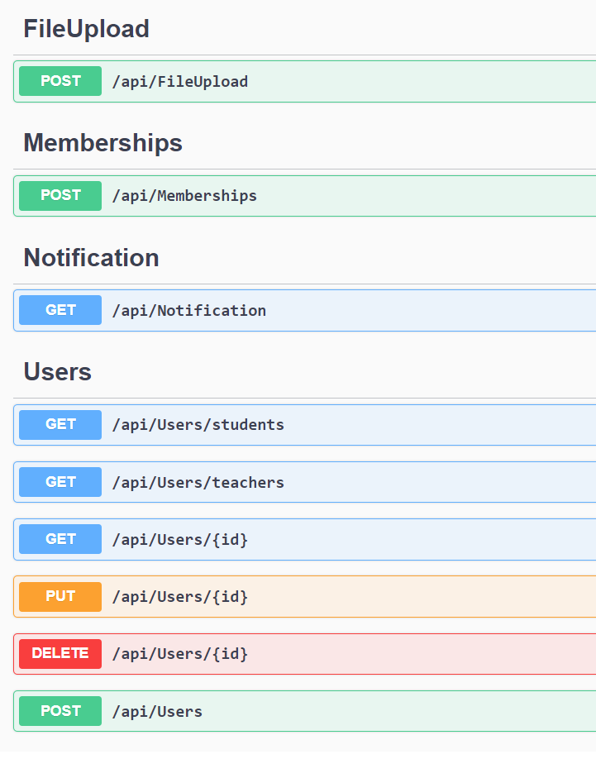
Server Side Apis - Swagger

Slide 16
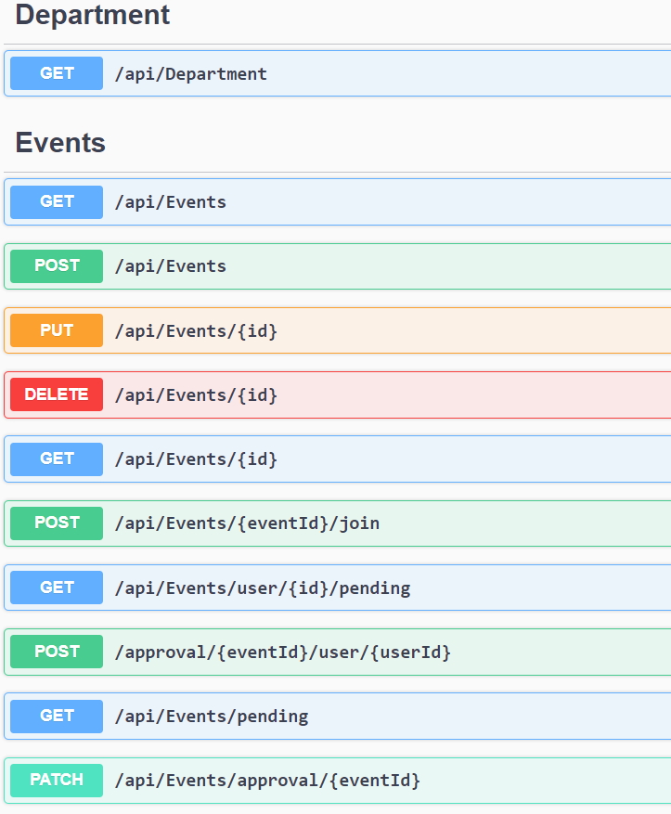
Server Side Apis - Swagger

Slide 17
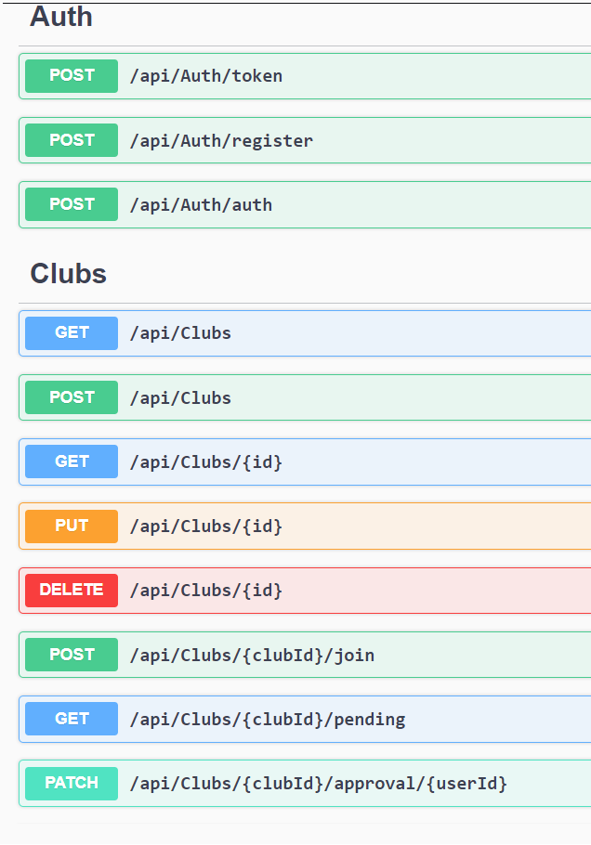
Server Side Apis - Swagger

Slide 18
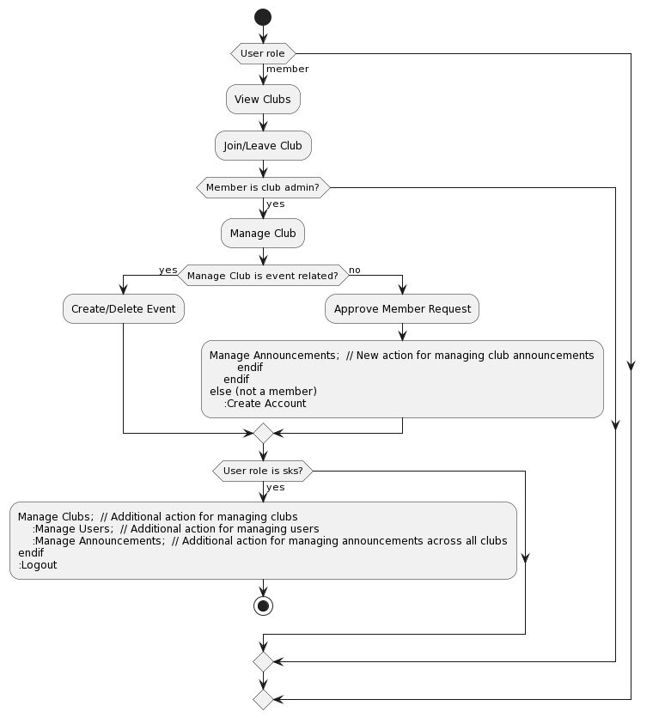
Activity Diagram

Slide 19
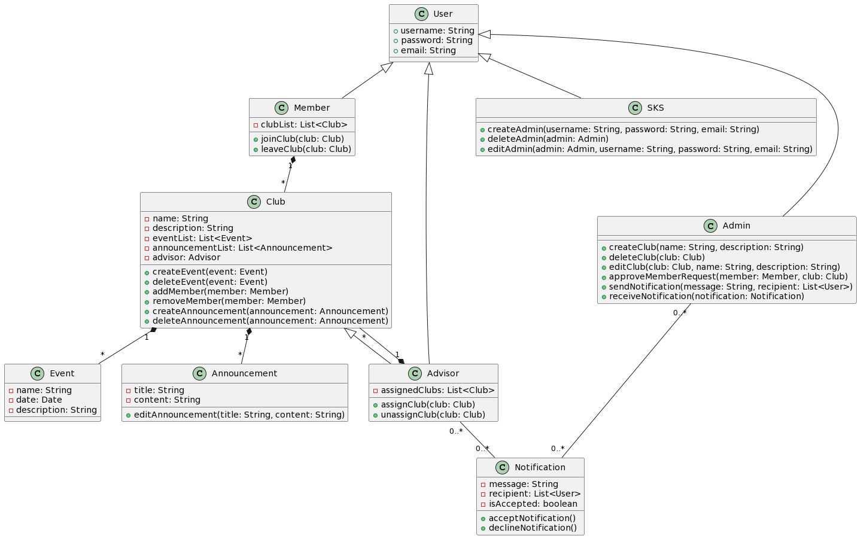
UML Diagram

Slide 20
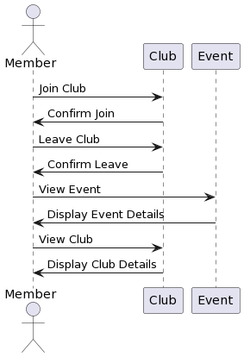
Member Use Case Diagram

Slide 21
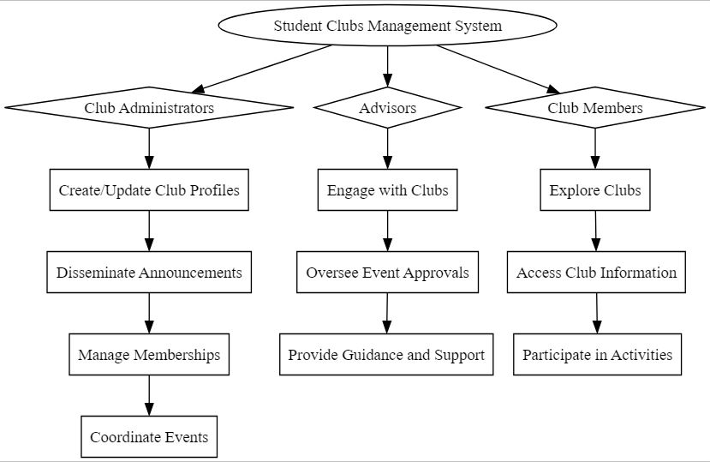
Flowchart

Slide 22
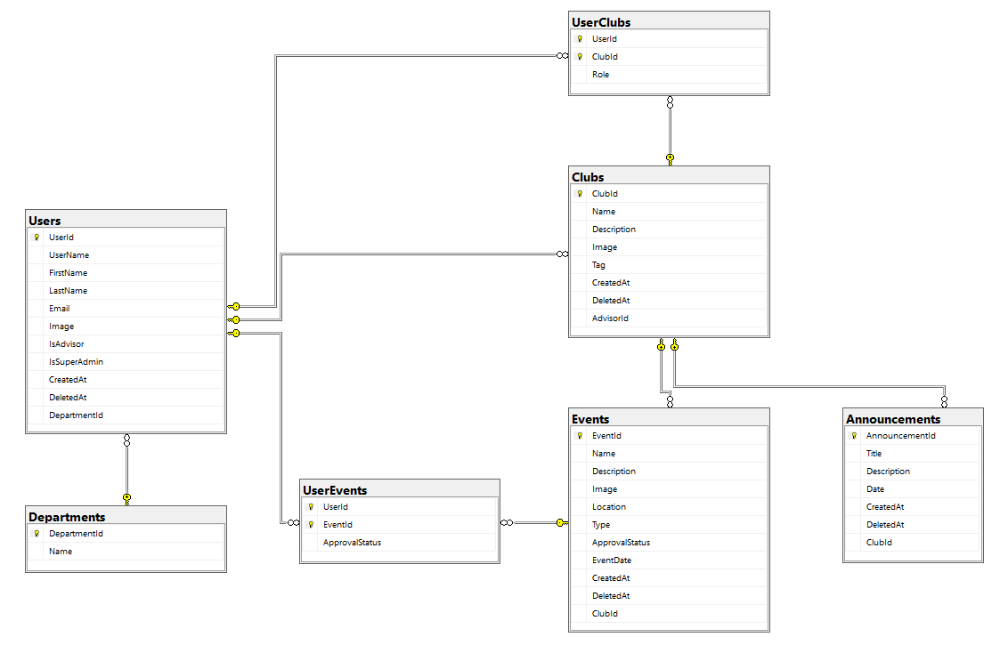
Database Relations

Slide 23
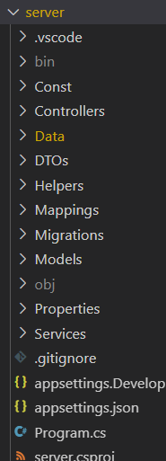
Repository - Server

Slide 24
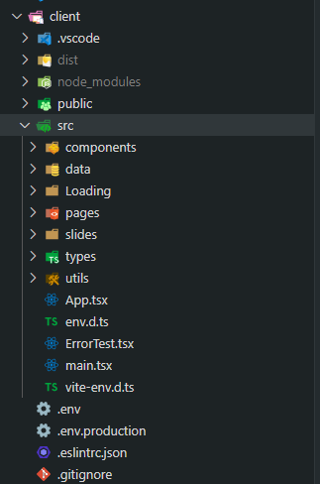
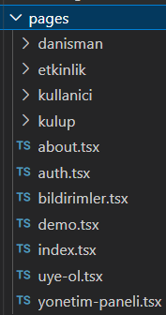
Repository - Client
Pages

Slide 25
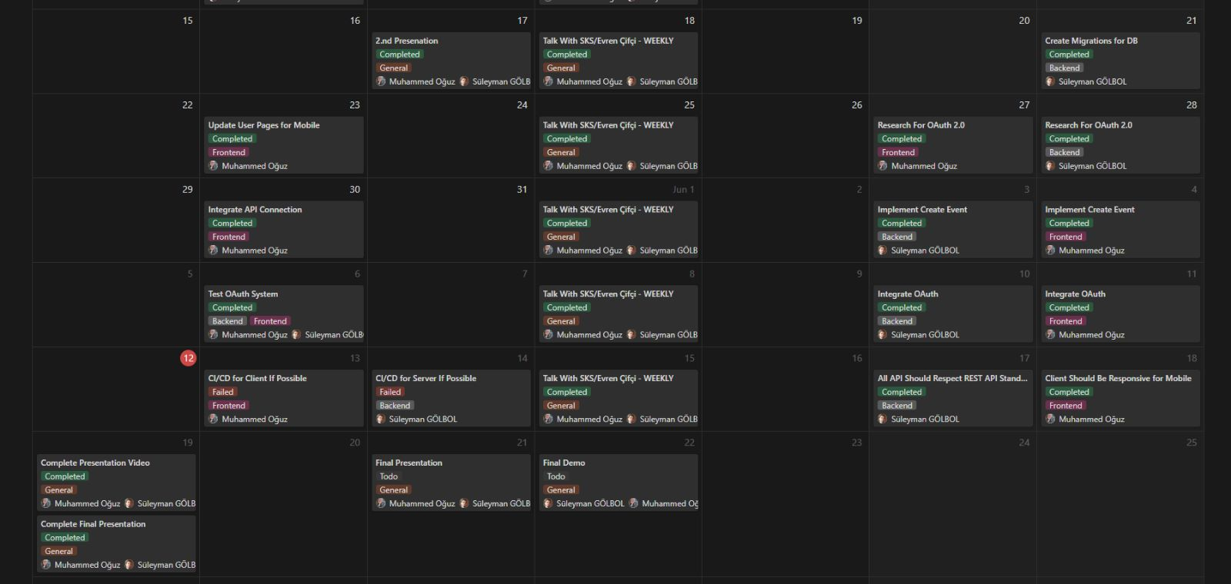
Timeline (Completed)

Slide 26
Timeline
1st Meeting (Preliminary Presentation) | April 05, 2023, Wednesday
2nd Meeting | May 17, 2023, Wednesday
Report Submission | June 18, 2023, Sunday
Trailer Submission | June 18, 2023, Sunday
3rd Meeting (Final Presentation) | June 21, 2023, Wednesday
Demo | June 22, 2023, Thursday

Slide 27
Success Criteria
1. The system should integrate with other systems or services as needed, such as OAuth2 portal for login authentication. ✅
2. Response should be made at most 1 seconds.✅
3. The system should be responsive for mobile and desktop devices.✅
4. APIs should be proper for REST.✅
All success criterias are achieved.

Slide 28
References
https://dotnet.microsoft.com/en-us/
https://react.dev/
https://nodejs.org/en
GTU BIM / SKS (Evren Çifci)

